Slide 1
EXCEL ASSESSMENT

Slide 2
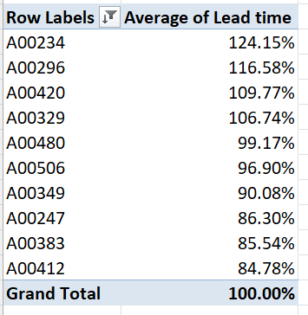
Average lead time b/w ReqDate and WrkDate for work orders

Slide 3
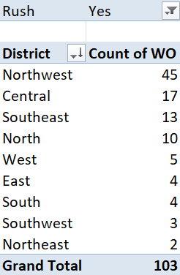
District with highest number of rush jobs
Filter Rush job as “YES” and find unique districts and its count of work orders. After sorting from largest to smallest, the district of “NORTHWEST” has highest rush jobs

Slide 4
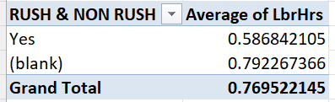
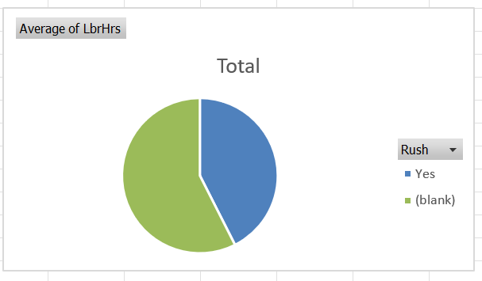
Average labour hours between rush and non-rush jobs

Slide 5
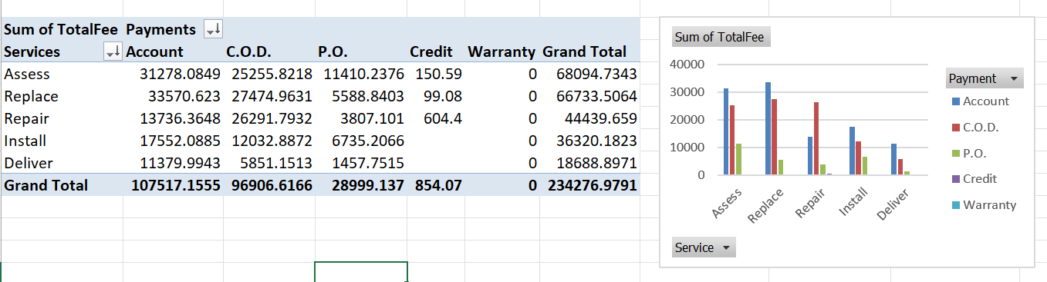
Distribution of payment across different services

Slide 6
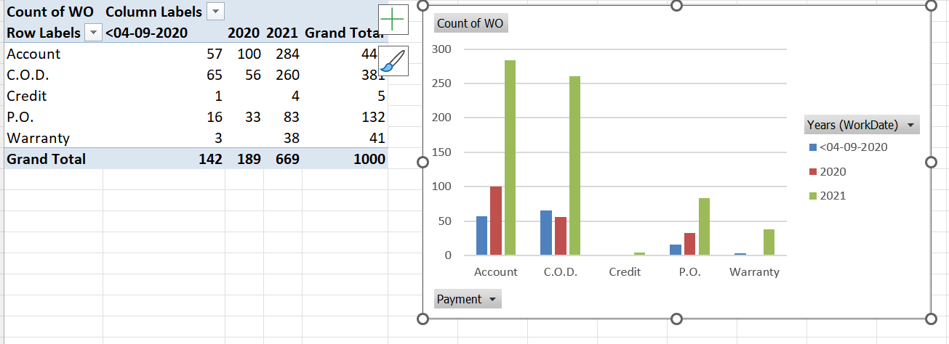
Distribution of payment over time

Slide 7
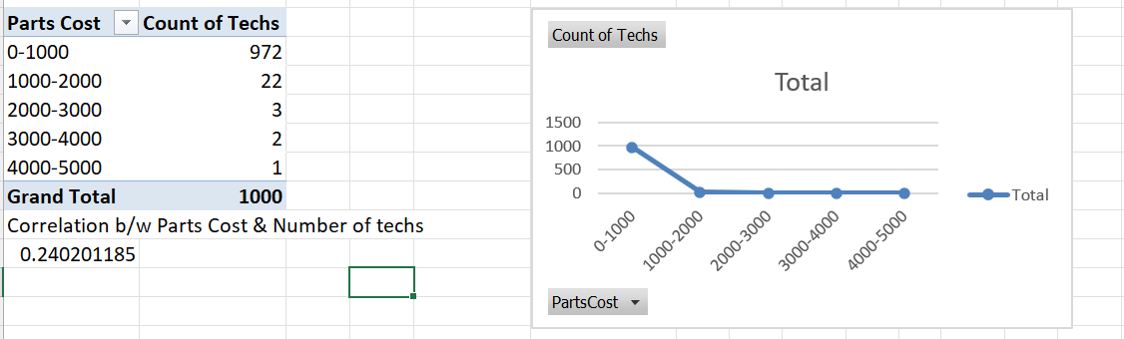
As the cost of parts increases, the number of techs decreases. The correlation b/w no: of techs and parts cost is weak and positive (0.240201185).

Slide 8
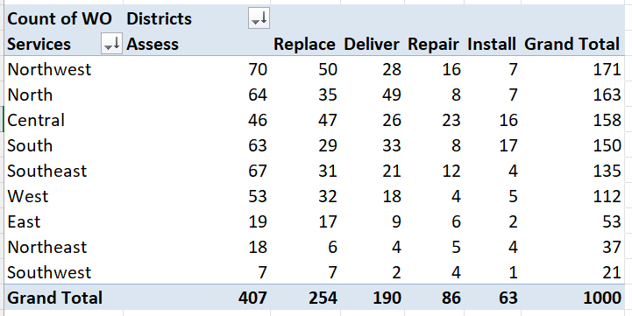
Assess is the most common type of service in each district.

Slide 9
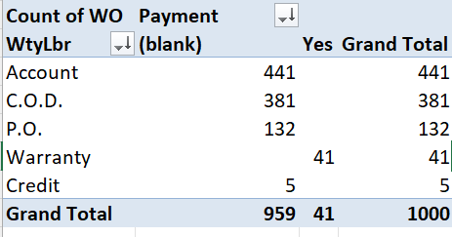
Difference in distribution of payment types in work orders with warranty labour compared to those without
The work orders are more for the payment type that doesn’t have warranty labour.

Slide 10
